Slide 1
Full Stack Development with MERN
Book World – MERN Full Stack Book Store

Slide 2
Introduction:
Project Title : Book World - MERN Full Stack Book Store
Team Members: Sruthi S

Slide 3
Project Overview:
Purpose:
The main objective of this project is to develop a full-stack online book store that allows users to explore books, manage their cart, and place orders through a secure and user-friendly platform. The application aims to provide a smooth shopping experience for customers and easy management features for administrators.
Features:
User registration and login
Browse books by category
Add books to cart
Place and view orders
Secure authentication
Admin management for books and users

Slide 4
Architecture :
Frontend:
The frontend is created using React.js with a component-based structure. It ensures reusability, fast rendering, and smooth navigation using React Router. State management is handled efficiently to manage cart and user data.
Backend:
The backend is built using Node.js and Express.js. It follows a RESTful architecture to manage requests related to users, books, cart, and orders. Middleware is used for authentication, error handling, and request validation.
Database:
MongoDB is used as the database to store user details, book information, cart items, and order records. Collections are designed to support scalability and efficient querying.

Slide 5
Setup Instructions :
Prerequisites:
Node.js
MongoDB
Visual Studio Code
Postman (for API testing)
Installation Steps:
Navigate to the frontend folder and install dependencies
Navigate to the backend folder and install dependencies
Configure environment variables
Start the MongoDB service

Slide 6
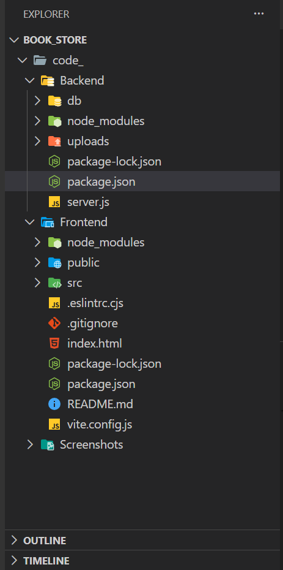
Folder Structure:
Frontend:
components – Reusable UI components pages like Home, Login, Cart
App.js – Routing and layout
Backend:
models – Database schemas
routes – API endpoints
controllers –Logics
middleware – Authentication & error handling

Slide 7
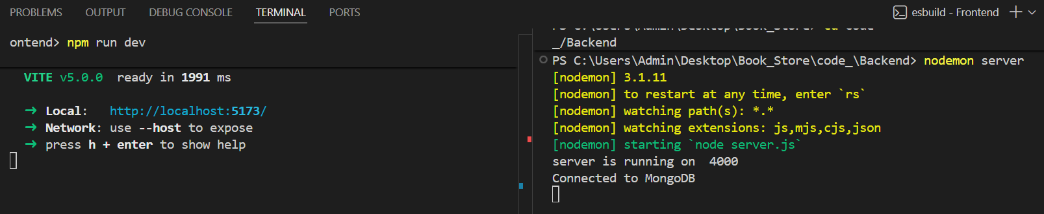
Running the Application:
Frontend:
cd code_/Frontend
    npm run dev
Backend:
    cd code_/Backend
    nodemon server.js

Slide 8
API Documentation
Method | Endpoint | Description
POST | /api/users/register | Register new user
POST | /api/users/login | Login user
GET | /api/books | Fetch all books
POST | /api/cart | Add item to cart
POST | /api/orders | Place order

Slide 9
Authentication
Authentication is implemented using JWT (JSON Web Tokens). After login, a token is generated and used to access protected routes. Role-based authorization ensures that only administrators can access admin-level features. Passwords are securely encrypted before storing in the database.

Slide 10
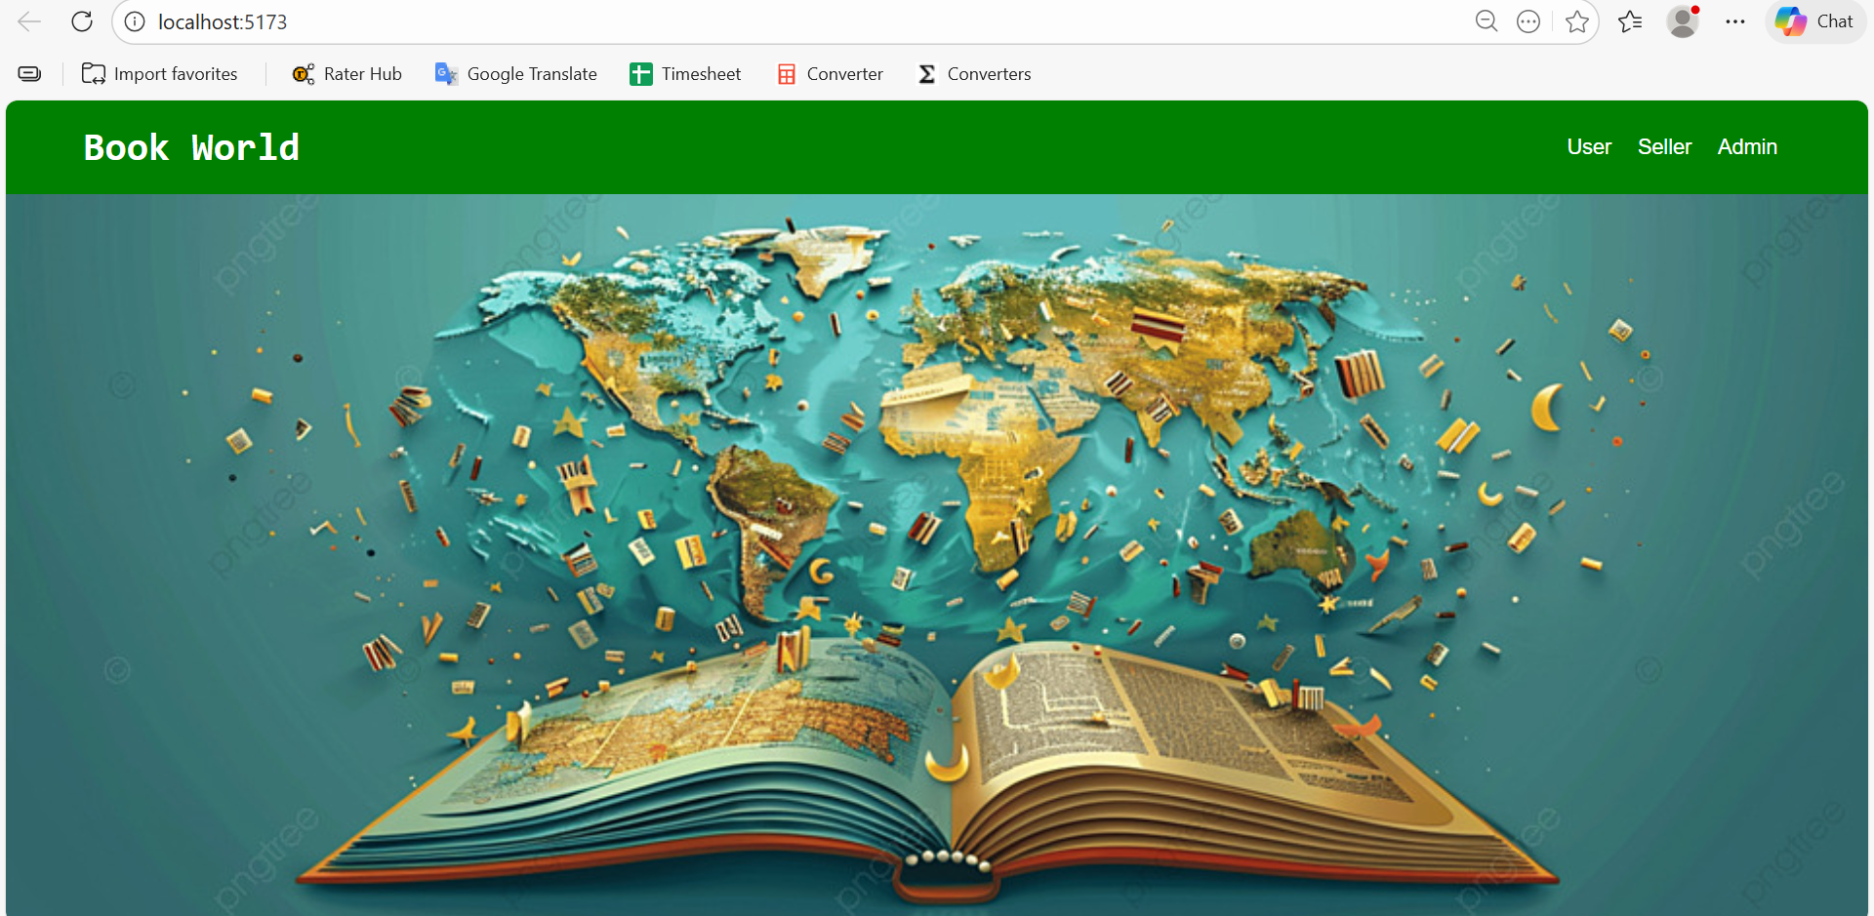
User Interface
The user interface is designed using React with a clean and responsive layout. The application includes pages such as home, book listing, cart, login, and order summary. The UI adapts well to both desktop and mobile screens.

Slide 11
Testing:
The backend APIs are tested using Postman, while frontend functionality is tested manually through the browser. Different scenarios such as login validation, cart operations, and order placement are verified to ensure reliability.

Slide 12
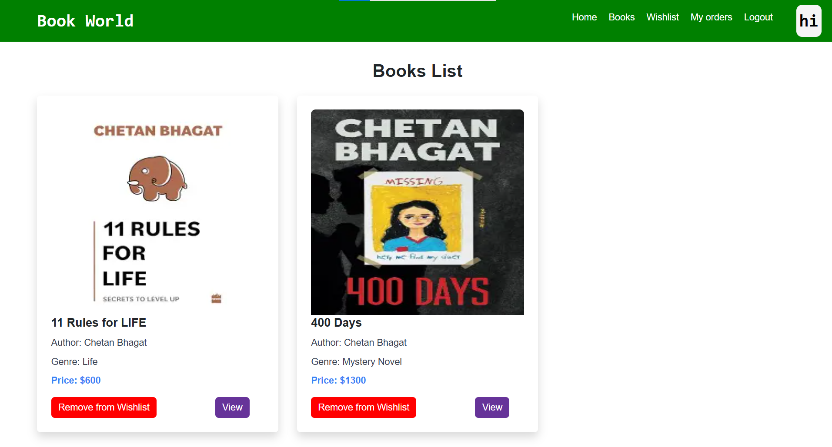
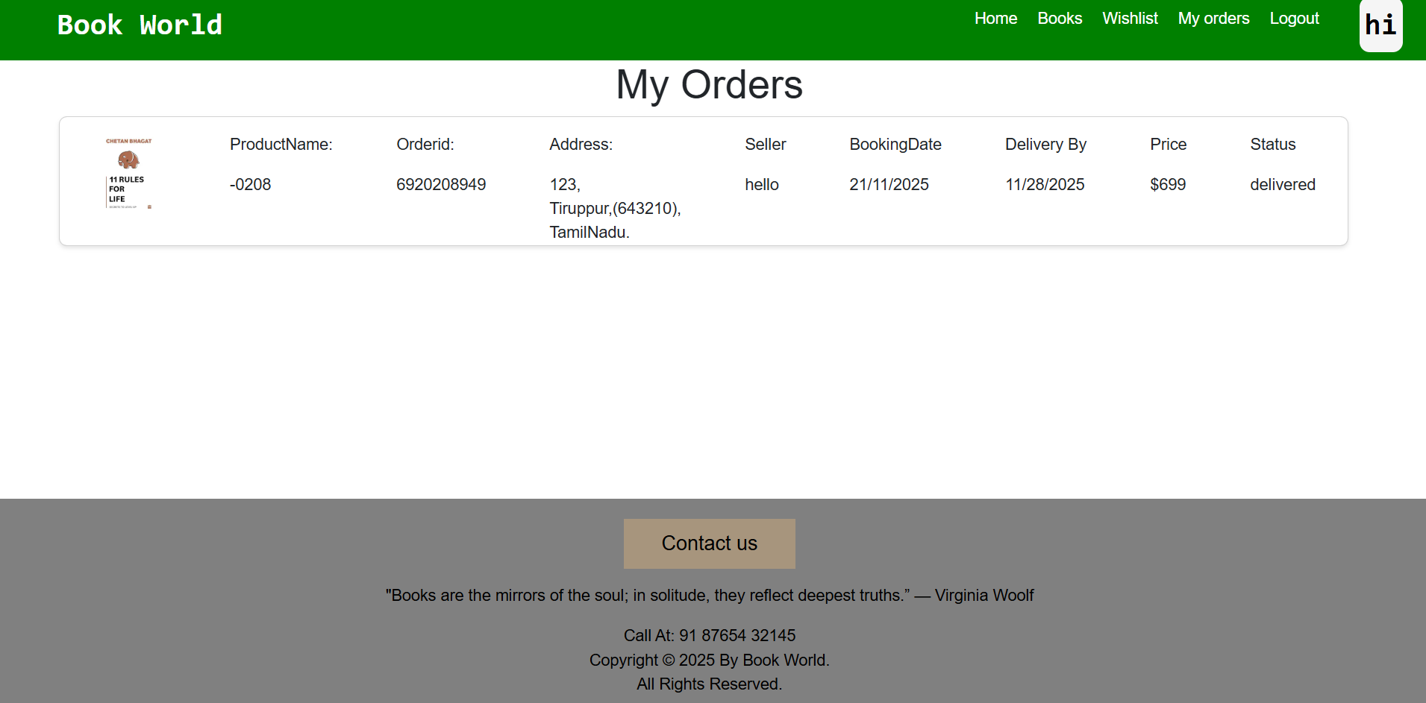
Screenshots or Demo:

Slide 13
Known Issues:
Online payment feature not implemented
Email notifications not available
Limited admin analytics
Pagination for admin dashboard can be improved

Slide 14
Future Enhancements
Integration of online payment gateway
Order tracking system
Wish list feature
Book reviews and ratings
Admin sales dashboard
Email and notification support

